Slide 1
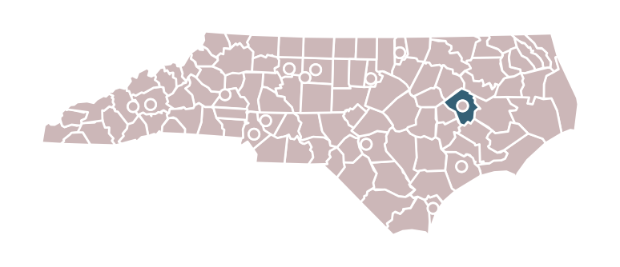
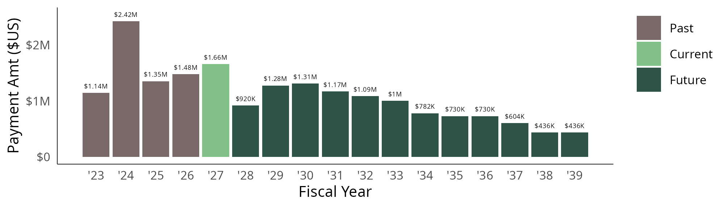
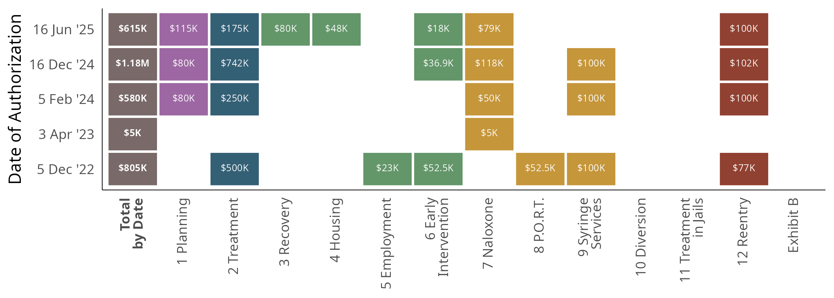
Pitt County
Summer 2026 Edition
printed 21 Aug 2026
Pitt County is set to receive approximately $18.5M in opioid settlement funds from 2022 through 2038. They have received $6.4M through June 2026 with $12.1M more anticipated.
In North Carolina, the state fiscal year begins on July 1 and runs through June 30. E.g., FY 2025 runs from July 1, 2024 through June 30, 2025.
Local governments are not required to spend funds within the fiscal year they are received, and these funds do not expire.
Pitt County has approved and shared 5 spending plans authorizing 10 unique strategies as of June 15, 2026.
Totals authorized by date (horizontal rows) have been provided in the first column. Totals author-ized by strategy (vertical columns) are not meaningful because of potential overlap, as authorizations can be extended, amended, or replaced, and unspent funds may be reauthorized later.

Slide 2
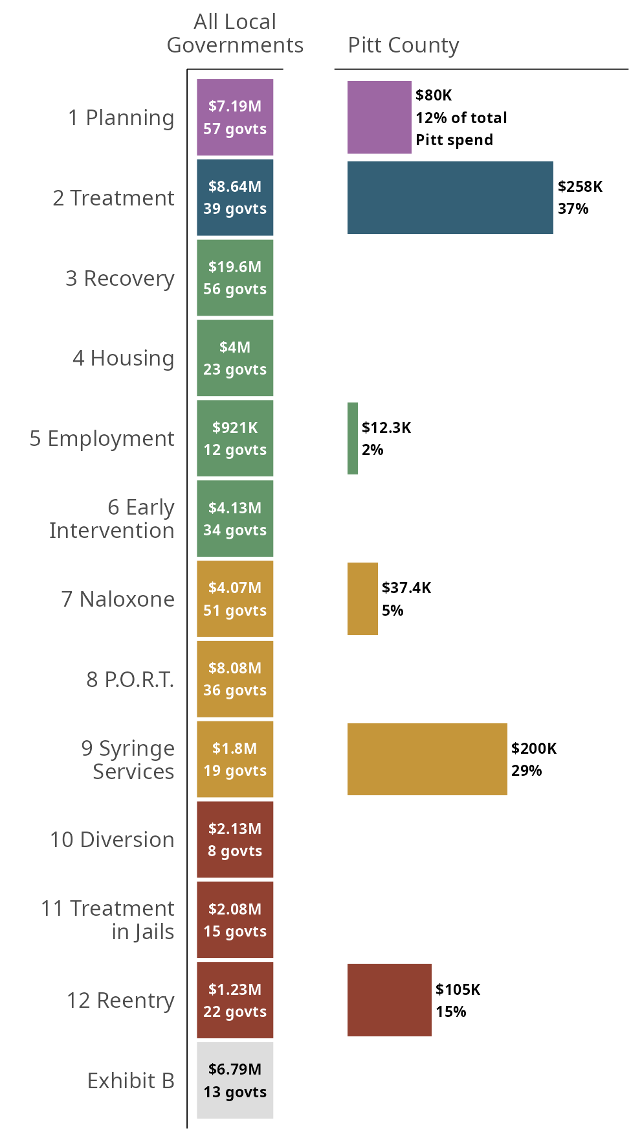
Pitt County
Summer 2026 Edition
Pitt County has spent $693K on 6 unique Exhibit A strategies as of June 2025.
Pitt County's most-funded strategies are:
• Evidence-Based Addiction Treatment: $258K.
• Syringe Services Program: $200K.
• Reentry Programs: $105K.
Local governments in North Carolina have collectively spent $70.7M; the three most locally-funded strategies across North Carolina are:
• Recovery Support Services: 56 governments have spent a total of $19.6M.
• Evidence-Based Addiction Treatment: 39 governments have spent a total of $8.64M.
• Post-Overdose Response Team: 36 governments have spent a total of $8.08M.
Spending through June 2025
2026-08-21 10:40

