Slide 1
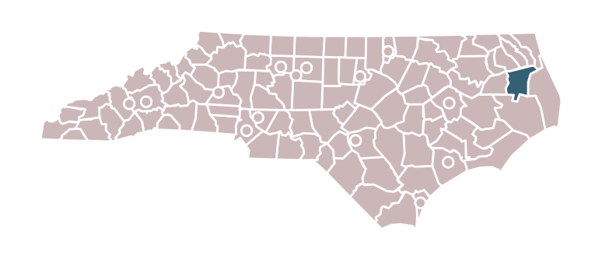
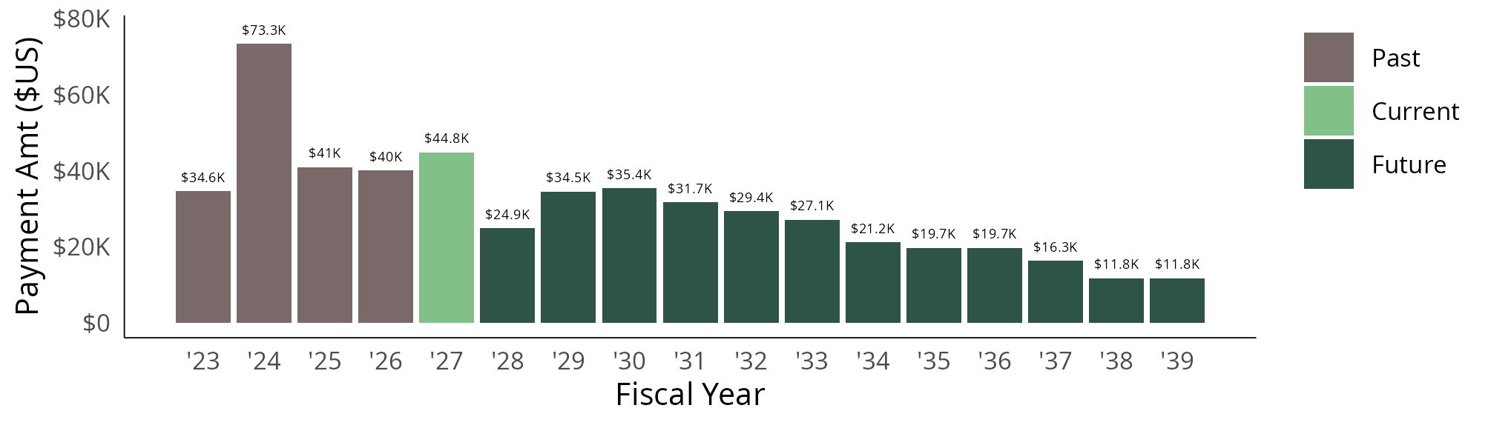
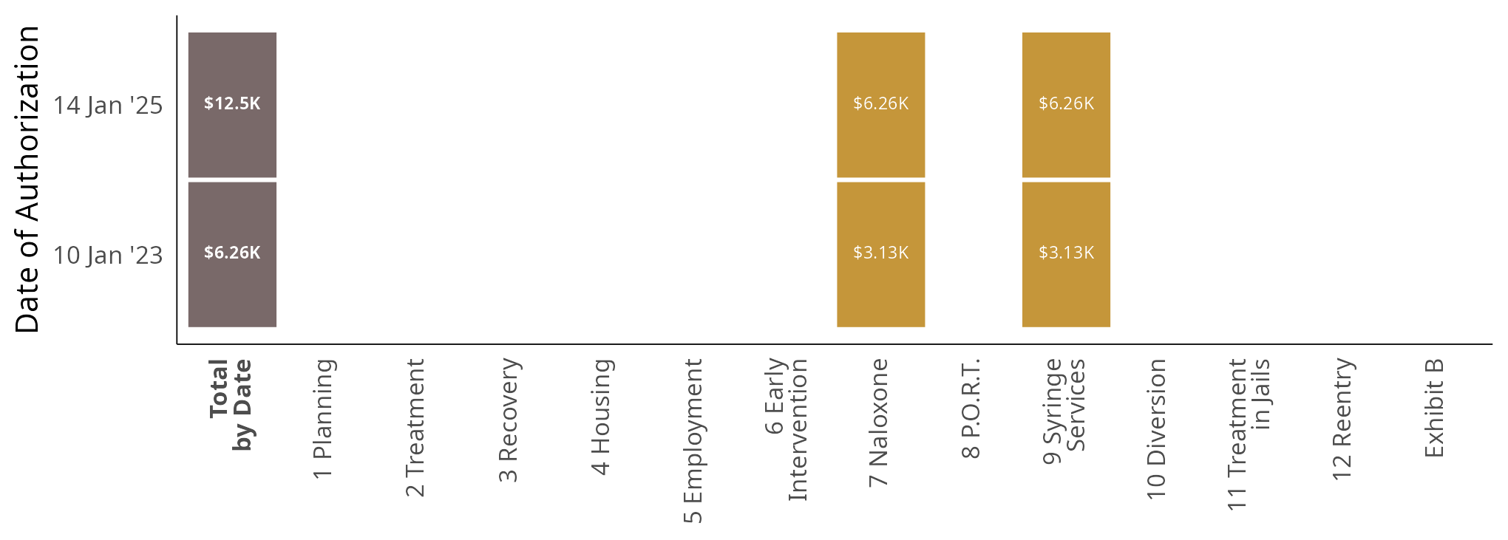
Tyrrell County
Summer 2026 Edition
printed 21 Aug 2026
Tyrrell County is set to receive approximately $517K in opioid settlement funds from 2022 through 2038. They have received $189K through June 2026 with $328K more anticipated.
In North Carolina, the state fiscal year begins on July 1 and runs through June 30. E.g., FY 2025 runs from July 1, 2024 through June 30, 2025.
Local governments are not required to spend funds within the fiscal year they are received, and these funds do not expire.
Tyrrell County has approved and shared 2 spending plans authorizing 2 unique strategies as of June 15, 2026.
Totals authorized by date (horizontal rows) have been provided in the first column. Totals author-ized by strategy (vertical columns) are not meaningful because of potential overlap, as authorizations can be extended, amended, or replaced, and unspent funds may be reauthorized later.

Slide 2
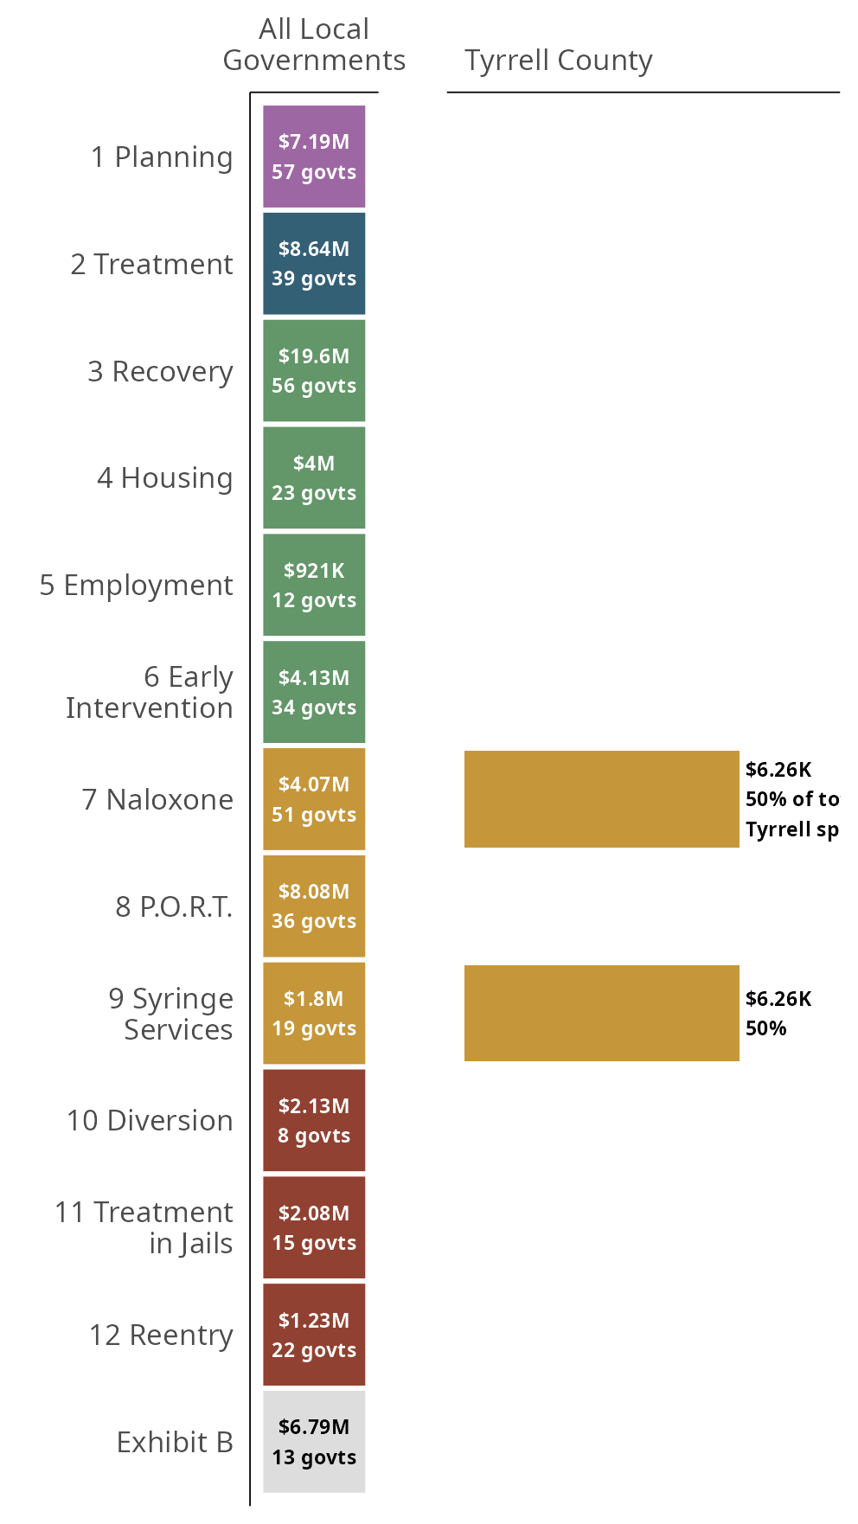
Tyrrell County
Summer 2026 Edition
Tyrrell County has spent $12.5K on 2 unique Exhibit A strategies as of June 2025.
Tyrrell County's most-funded strategies are:
• Naloxone Distribution: $6.26K.
• Syringe Services Program: $6.26K.
Local governments in North Carolina have collectively spent $70.7M; the three most locally-funded strategies across North Carolina are:
• Recovery Support Services: 56 governments have spent a total of $19.6M.
• Evidence-Based Addiction Treatment: 39 governments have spent a total of $8.64M.
• Post-Overdose Response Team: 36 governments have spent a total of $8.08M.
Spending through June 2025
2026-08-21 10:40

